Slide 1
Capstone Project
Customer Segmentation
-Rahul Deshmukh

Slide 2
Problem Statement:
In this project, your task is to identify major customer segments on a transnational data set which contains all the transactions occurring between 01/12/2010 and 09/12/2011 for a UK-based and registered non-store online retail.The company mainly sells unique all-occasion gifts. Many customers of the company are wholesalers.

Slide 3

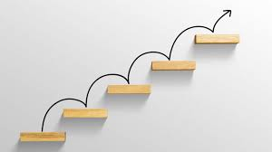
Key Steps:
Defining the problem statement
Data Cleaning
EDA and data visualization
Data preprocessing
Feature selection
Preparing Dataset for model
Applying model
Model validation and selection

Slide 4
Why is analytics useful for Customer segmentation ?
To know Recency of customers.
To know Frequency of customers.
To know Monetary Value of customers.

Slide 5
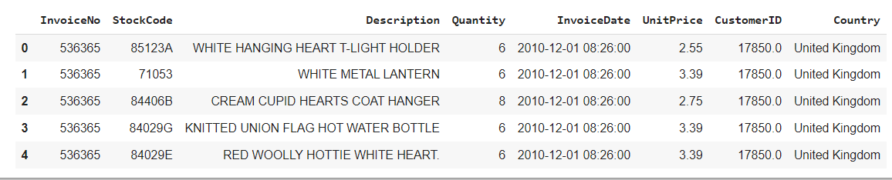
Dataset :
Rows : 541909
Columns : 8

Slide 6
Variable Names:
InvoiceNo:
Stock Code:
Description:
Quantity:
InvoiceDate:
Unit Price:
CustomerID:
Country:

Slide 7
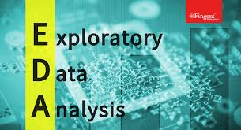
Exploratory Data Analysis:
EDA is used for analyzing what the data can tell us before the modeling or by applying any set of instructions/code.

Slide 8
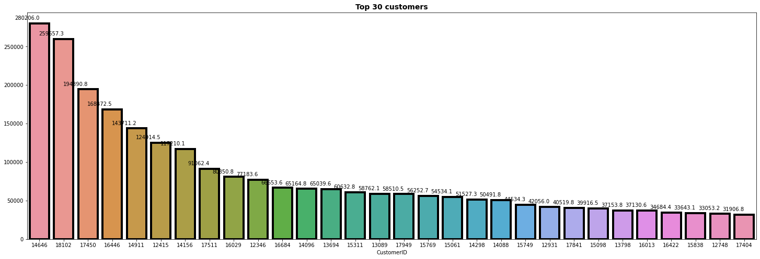
Top 30 customers who visit often and spend well :

Slide 9
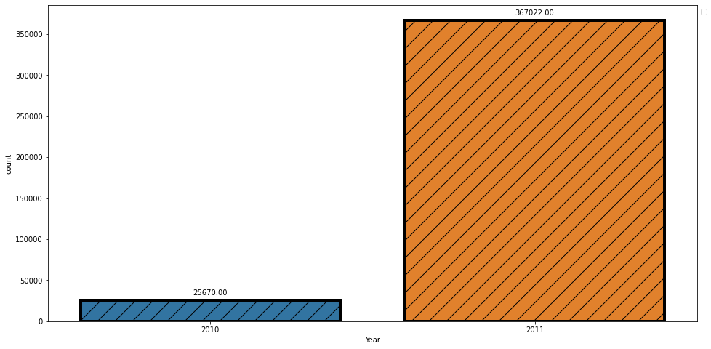
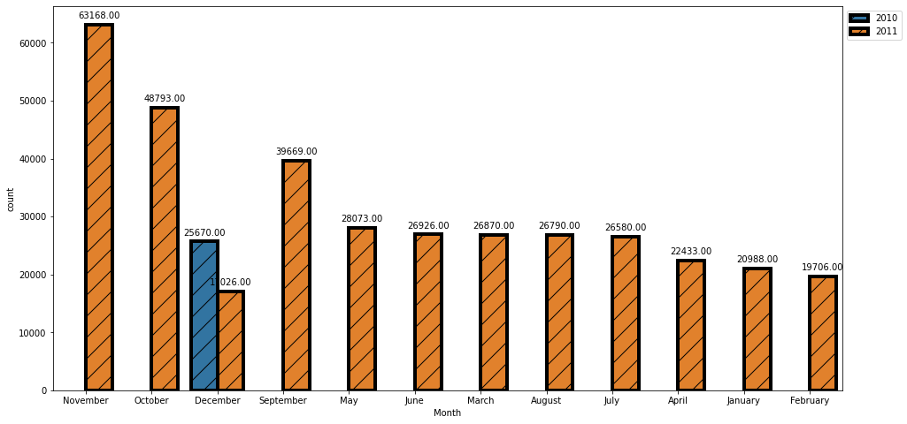
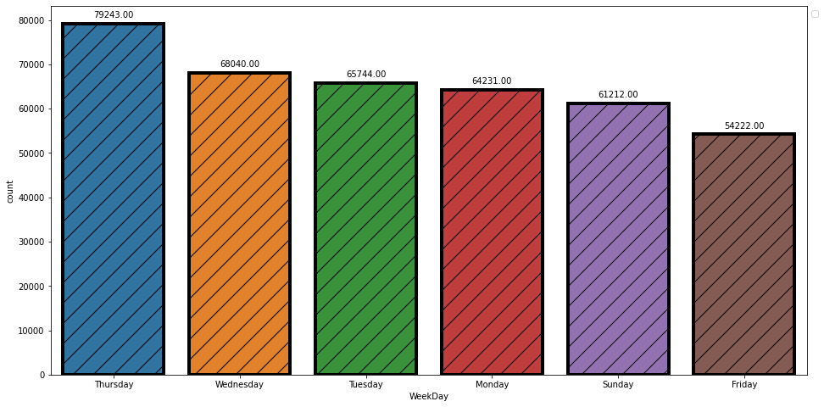
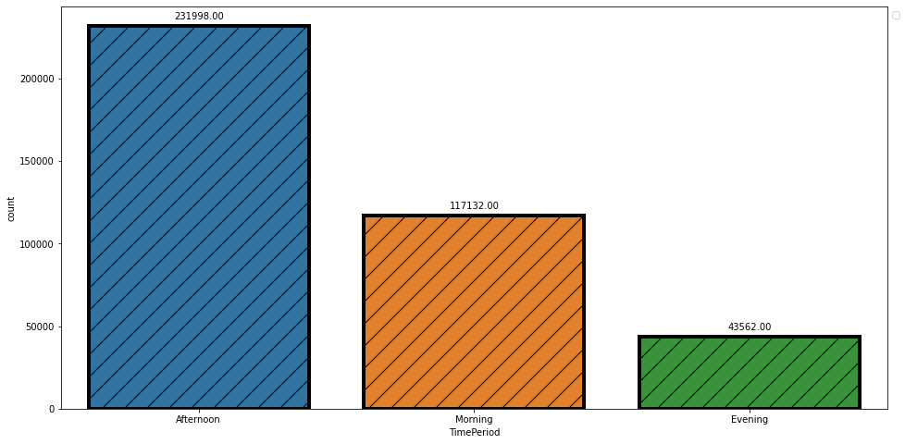
Periodical purchasing stats:

Slide 10
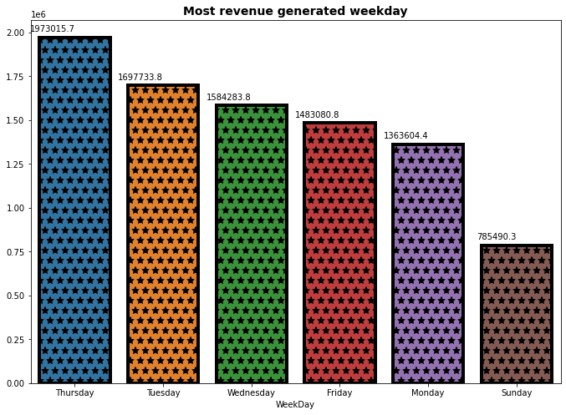
Most revenue generated weekday:

Slide 11
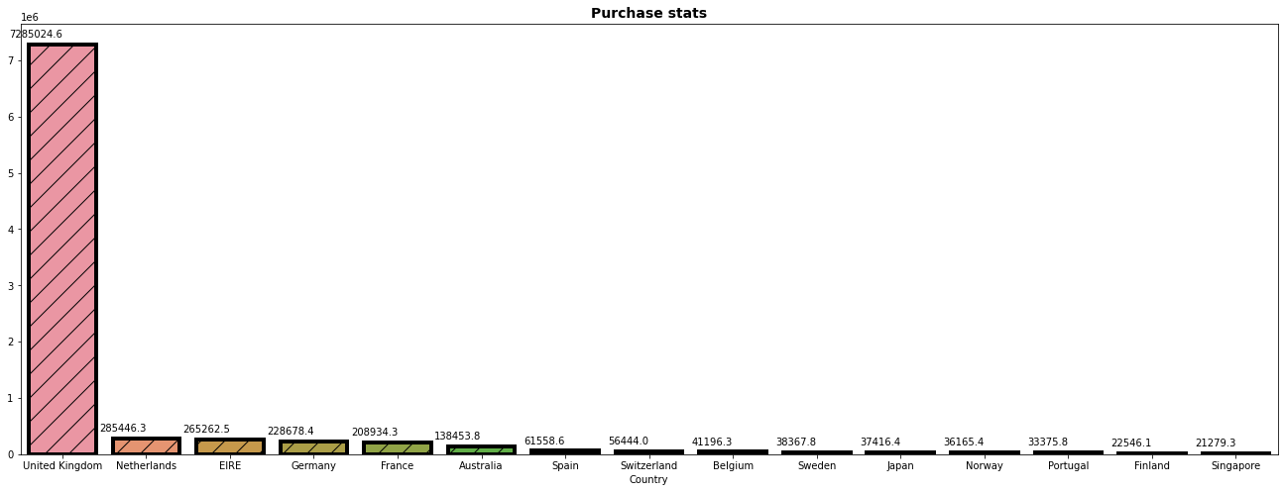
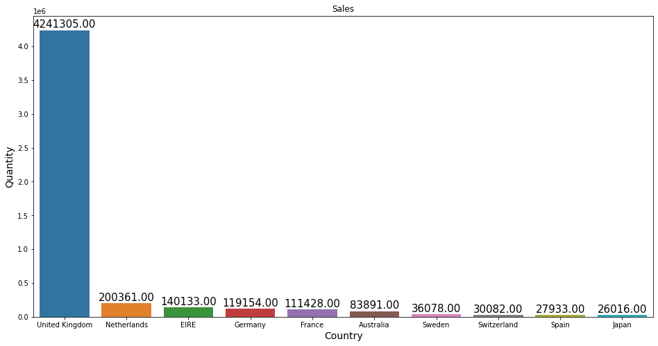
High quantity buying and high purchasing countries stats:

Slide 12
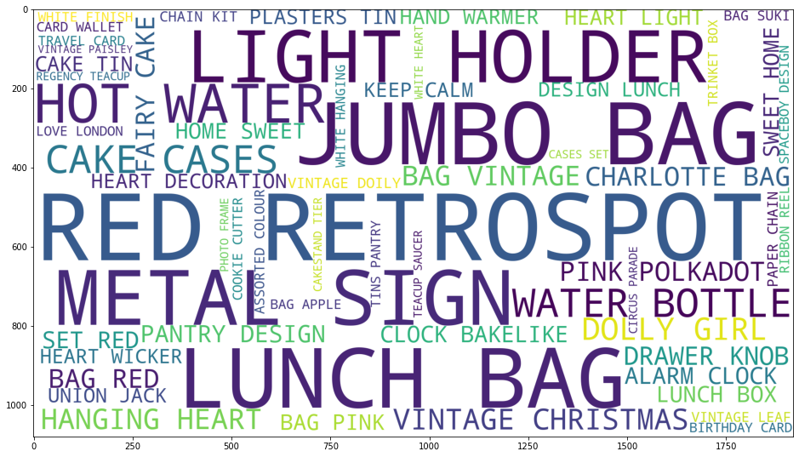
Product Sales Categorization:

Slide 13
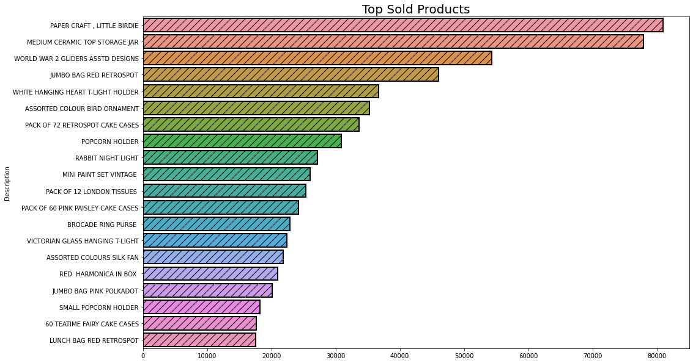
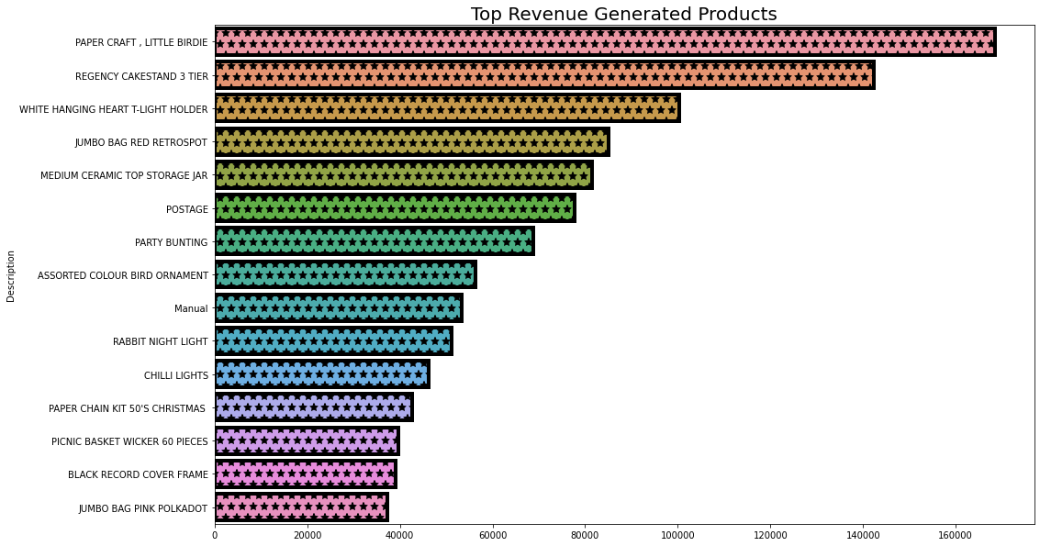
Top sold and revenue generated product:

Slide 14
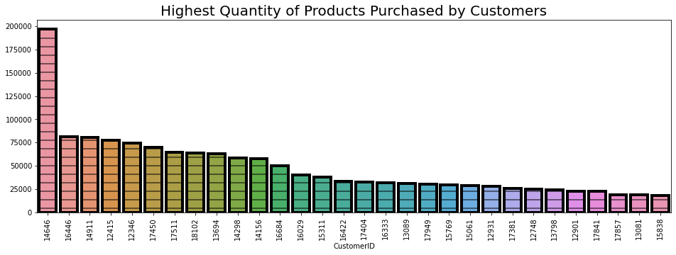
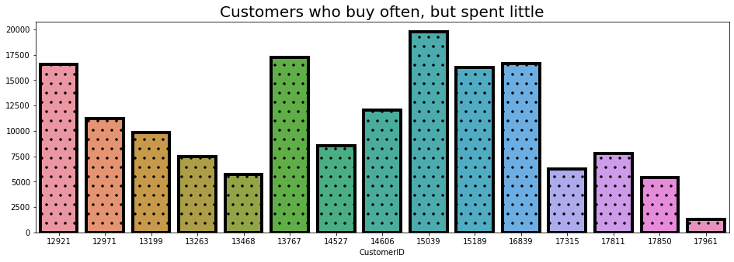
Highest quantity of products purchased by customer and Customers who buy often but spend very little:

Slide 15
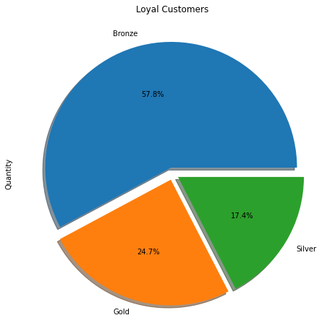
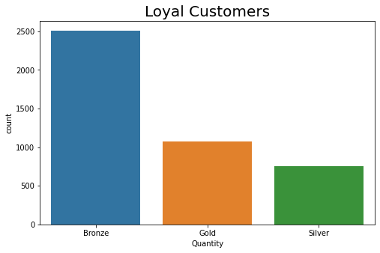
Customers category:

Slide 16
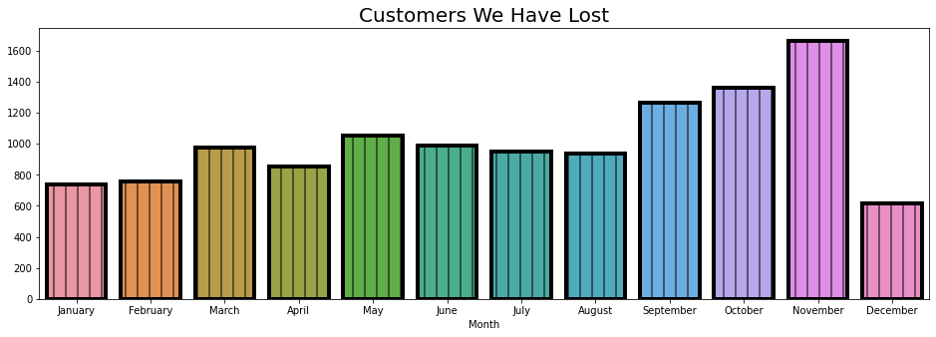
Most customers lost in month:

Slide 17
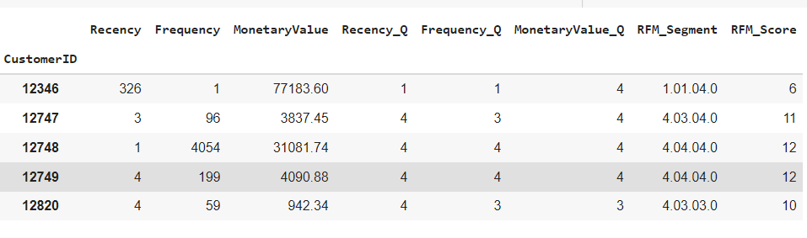
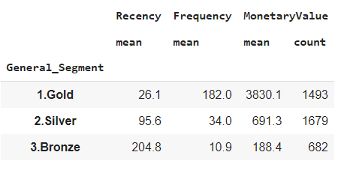
Recency, Frequency and Monetary Value score:
The recency, frequency, monetary value (RFM) model is based on three quantitative factors namely recency, frequency, and monetary value. Each customer is ranked in each of these categories, generally on a scale of 1 to 5 (the higher the number, the better the result). The higher the customer ranking, the more likely it is that they will do business again with a firm. Essentially, the RFM model corroborates the marketing adage that "80% of business comes from 20% of the customers."

Slide 18
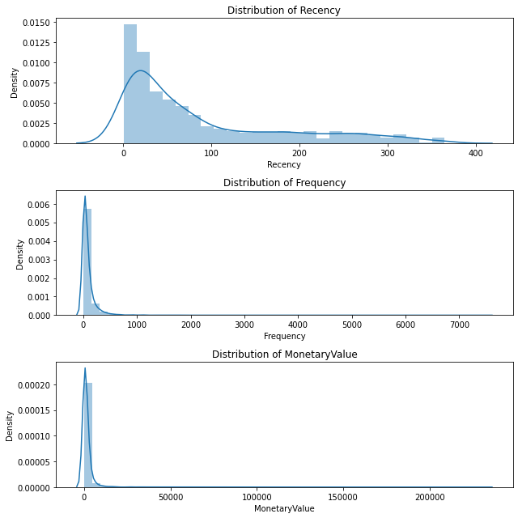
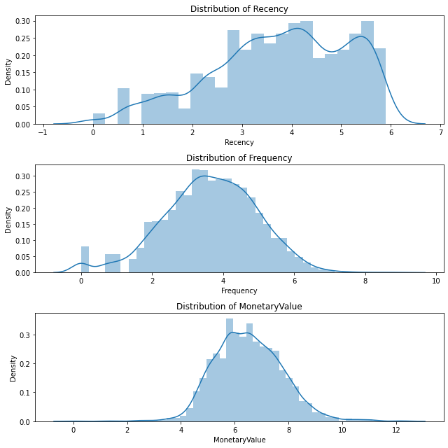
Before and after log transformation:

Slide 19
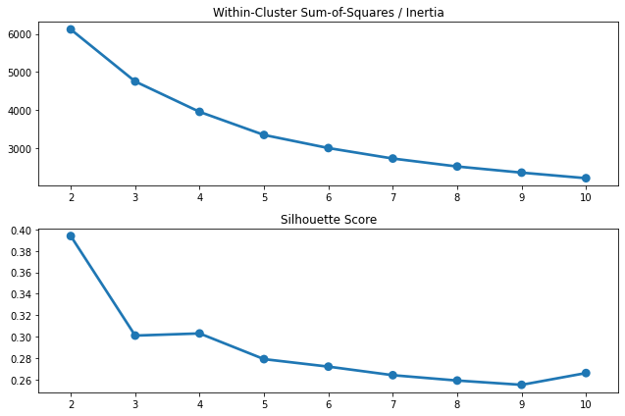
Finding Optimal Cluster:

Slide 20
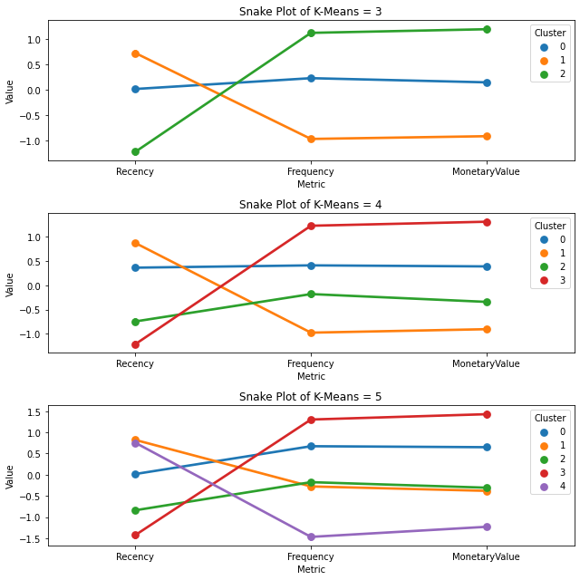
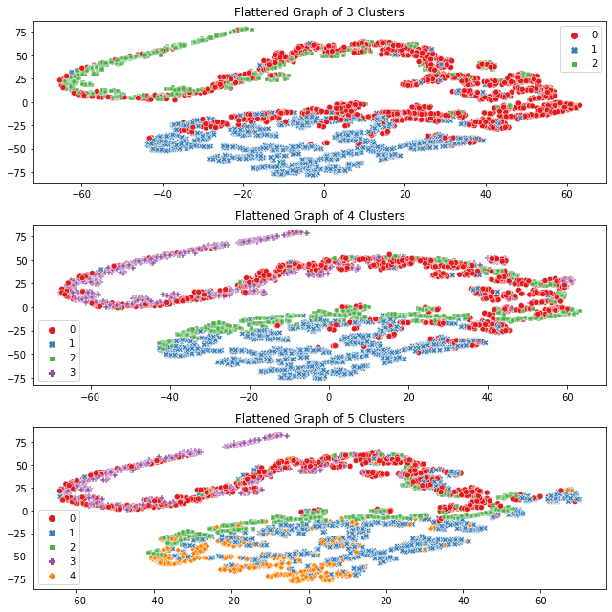
Model used:
KMeans Clustering:

Slide 21
Classification models used for prediction:
Logistic Regression:
Random Forest:
XGBoost:
Observation:
I’ve used logistic Regression at first but the score was bit less, after that I’ve used Tree based algorithm i.e. Random forest and XGBoost and with Random forest I got highest score as compared to other two so, random forest is my optimal model which can be used for further.

Slide 22
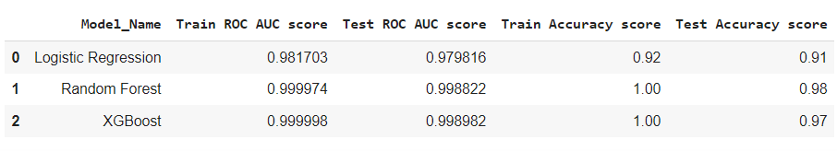
Evaluation Matrix:

Slide 23

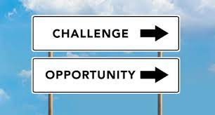

Challenges:
Loading dataset takes time.
As there were many null values present in data set it took time to clean the dataset.
Difficulty in selecting the appropriate graph for trend.

Slide 24

Summary of conclusion:
The customer segments thus deduced can be very useful in targeted marketing, scouting for new customers and ultimately revenue growth. After knowing the types of customers, it depends upon the retailer policy whether to chase the high value customers and offer them better service and discounts or try and encourage low/ medium value customers to shop more frequently or of higher monetary values.

